Slide 1


Traffic with AI
Created by Joan Vendrell

Slide 2


Working with Machine learning
1. Attempting to minimize the occurrence of spontaneous traffic jams
2. Knowing that something is going to cause enough of a traffic perturbation to result in a network breakdown
3. Assuming that the probability of traffic breakdown occurrence is larger than zero
4. Working to maximize the probability that none of the network links encounters a traffic breakdown

Slide 3

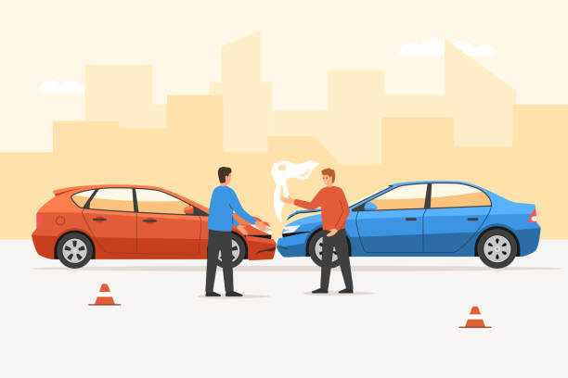
The solution is not easy...

Slide 4
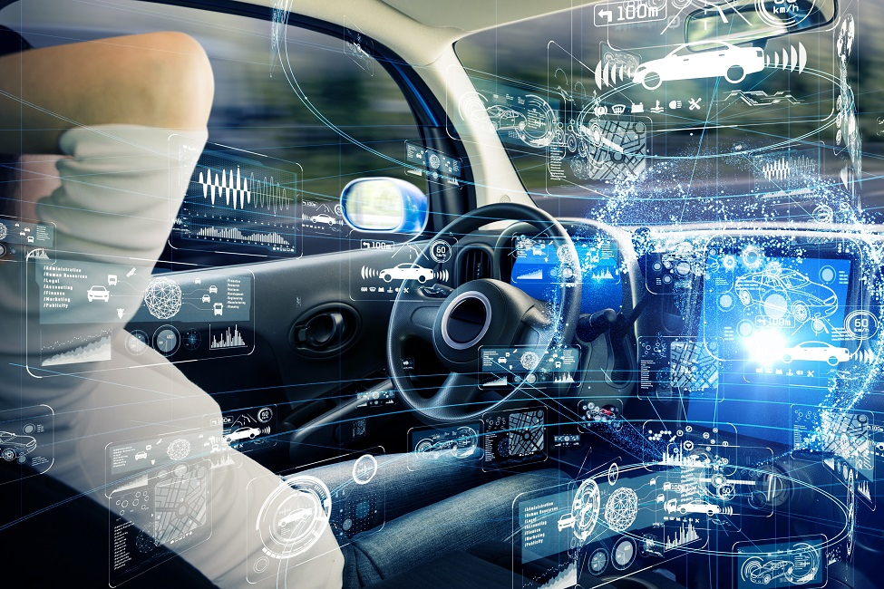
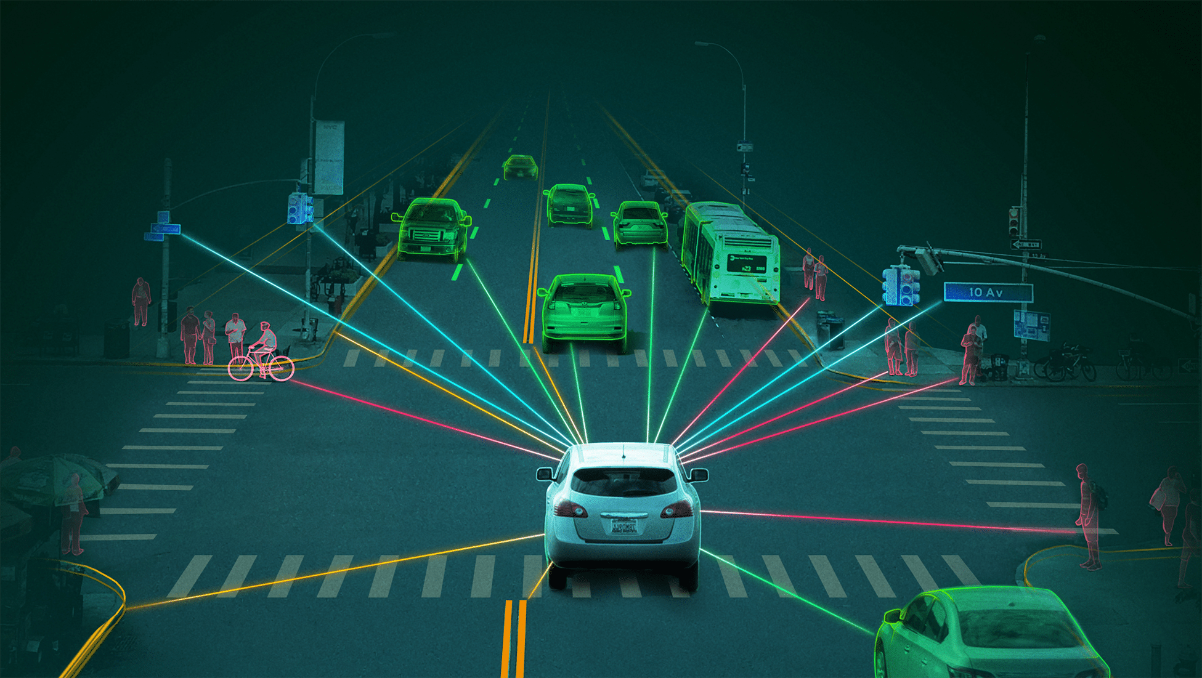
But we know it...

Slide 5
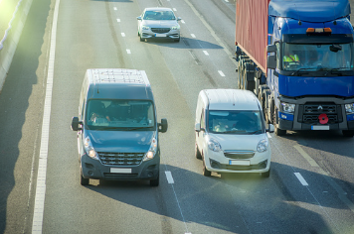
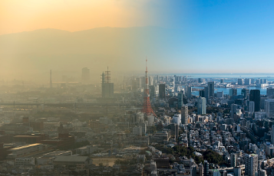
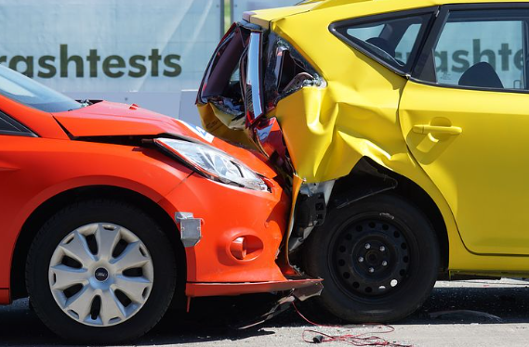

The road’s network future with AI
1. Less congestion
2. Less pollution
3. Less crashes
4. More free time

Slide 6

Thank you for your attention!

